Slide 1
User Interface Design

Slide 2
Characteristics of a user interface
Speed of learning: A good user interface should be easy to learn and it should not require its users to memorize commands.
Attractiveness. A good user interface should be attractive to use. In this respect, graphics-based user interfaces have a definite advantage over text-based interfaces.
Consistency. The commands supported by a user interface should be consistent. Consistency facilitates speed of learning

Slide 3
Characteristics of a user interface
Feedback. A good user interface must provide feedback to various user actions.
Error recovery (undo facility). While issuing commands, even the expert users can commit errors. Therefore, a good user interface should allow a user to undo a mistake committed by him while using the interface.
User guidance and on-line help. Users seek guidance and on-line help when they either forget a command or are unaware of some features of the software. Whenever users need guidance or seek help from the system, they should be provided with the appropriate guidance and help.

Slide 4
Characteristics of a user interface
7. Speed of use
8. Speed of recall
9. Error prevention

Slide 5
Graphical User Interface vs. Text-based User Interface
  In a GUI multiple windows with different information can simultaneously be displayed on the user screen. This is perhaps one of the biggest advantages of GUI over text-based interfaces.
  Iconic information representation and symbolic information manipulation is possible in a GUI

Slide 6
A GUI usually supports command selection using an attractive and user-friendly menu selection system.
In a GUI, a pointing device such as a mouse or a light pen can be used for issuing commands. The use of a pointing device increases the efficacy issue procedure.
On the other hand, a text-based user interface can be implemented even on a cheap alphanumeric display terminal.
Graphics terminals are usually much more expensive than alphanumeric terminals.

Slide 7
Types of user interfaces
User interfaces can be classified into the following three categories:
  Command language based interfaces
  Menu-based interfaces
  Direct manipulation interfaces

Slide 8
Command Language-based Interface
is based on designing a command language which the user can use to issue the commands.
The user is expected to frame the appropriate commands in the language and type them in appropriately whenever required.
Command language-based interfaces allow fast interaction with the computer and simplify the input of complex commands.

Slide 9

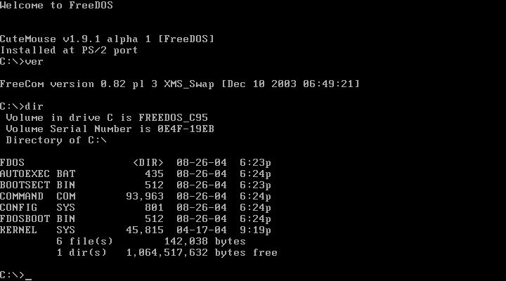
Examples

Slide 10
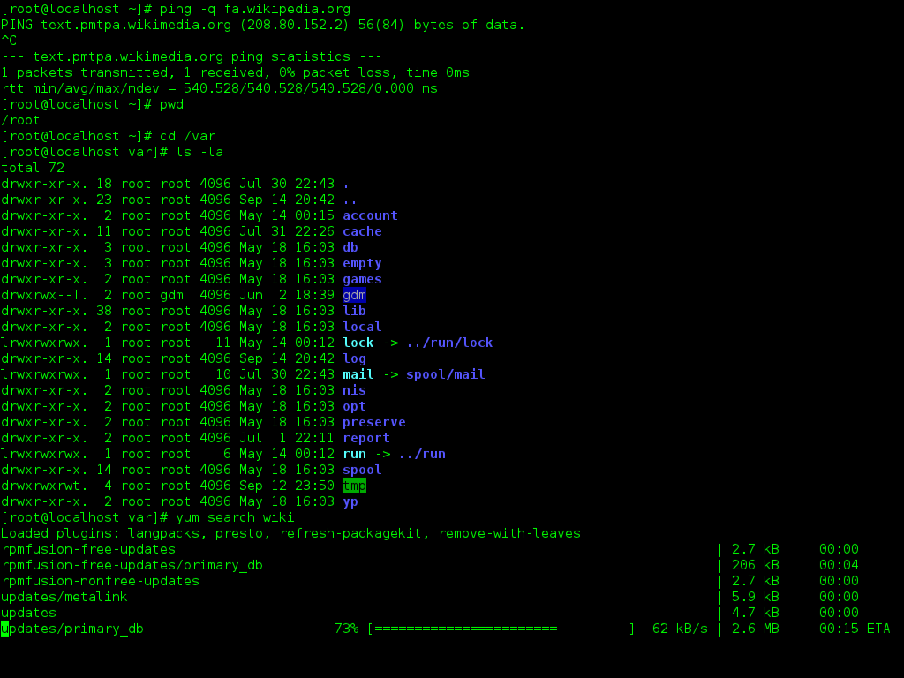

Slide 11
Menu-based Interface
An important advantage of a menu-based interface over a command language-based interface is that a menu-based interface does not require the users to remember the exact syntax of the commands.
A menu-based interface is based on recognition of the command names, rather than recollection.

Slide 12
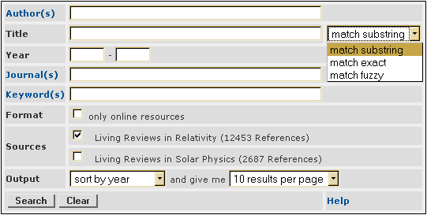
Examples

Slide 13
Direct Manipulation Interfaces
Direct manipulation interfaces present the interface to the user in the form of visual models (i.e. icons or objects).
For this reason, direct manipulation interfaces are sometimes called as iconic interface.
In this type of interface, the user issues commands by performing actions on the visual representations of the objects, e.g. pull an icon representing a file into an icon representing a trash box, for deleting the file.

Slide 14

Examples

Slide 15

Examples

Slide 16
Important advantages of iconic interfaces include the fact that the icons can be recognized by the users very easily, and that icons are language-independent.

